Slide 1

Learning Collaborative to Address Diabetes Prevention
Diabetes Care Begins With Diabetes Prevention
Notes:
Dani’s slide
Welcome

Slide 2
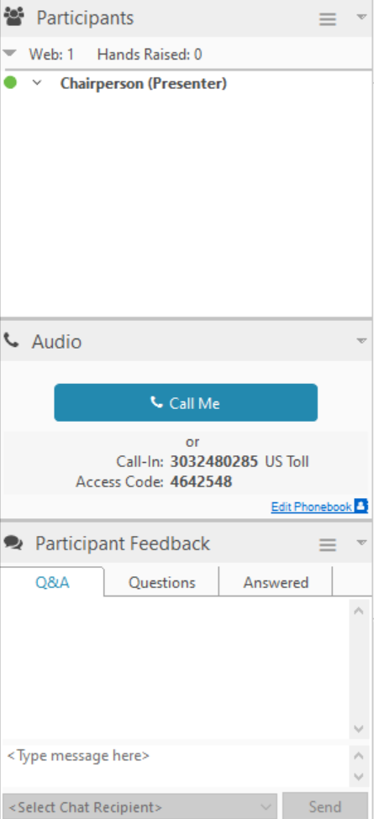

Housekeeping
Please stay in listen-only mode. You may unmute when it’s time for Q/A.
This webinar will be recorded and shared via email.
If you have any questions, please type them in the Q/A box and we will address them during the Q/A session.
ACPM will email the participants a brief feedback survey after the webinar.

Slide 3
Learning Objectives
Describe the clinical practice burden and trends in prediabetes and type 2 diabetes
Review the evidence that supports systematically screening patients for prediabetes, and referring to a community-based program, like the National Diabetes Prevention Program, to prevent type 2 diabetes
Identify the tools available to identify patients with prediabetes and establish a referral process
Describe shared decision making and how this patient-centered treatment approach can improve outcomes for patients with prediabetes

Slide 4


Slide 5


Slide 6
Clinical Burden of Prediabetes

Slide 7

Alex
Referral Nephrology
Prior authorizations
Ongoing refills
Ongoing labs
Medical complications
Anemia
Osteoporosis
Edema
2003 Prediabetes age 55
2006 Type 2 Diabetes
2016 Retinopathy
2020 CKD

Slide 8


Prevention of diabetes begins with identification of those at risk
84 MILLION ADULTS
HAVE PREDIABETES
1 IN 3 ADULTS HAS PREDIABETES
3
Centers for Disease Control and Prevention. National Diabetes Statistics Report, 2017. Atlanta, GA: Centers for Disease Control and Prevention, U.S. Dept of Health and Human Services; 2017.
8
Notes:
.

Slide 9
Review of Evidence and Guidelines

Slide 10
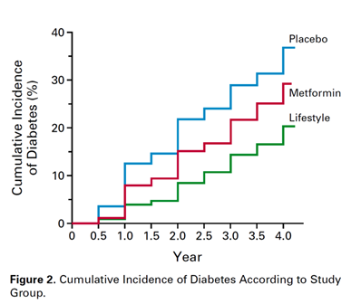
Evidence supporting lifestyle intervention and pharmacotherapy for diabetes prevention: US Diabetes Prevention Program study
NIH-funded 3-arm RCT of over 3,000 adults at high risk for diabetes comparing placebo vs metformin vs intensive lifestyle intervention
  Forty-five percent of study participants were members of a minority group (African American, Hispanic, Asian, Pacific Islander and American Indian)
  Study participants also included those over the age of 60
The lifestyle intervention reduced the incidence of diabetes by 58% (at average 3 years follow-up) compared to placebo; pharmacotherapy with metformin reduced the incidence of diabetes by 31% compared to placebo
Knowler WC, Barrett-Connor E, Fowler SE, et al.; Diabetes Prevention Program Research Group. Reduction in the incidence of type 2 diabetes with lifestyle intervention or metformin. N Engl J Med. 2002;346:393–403.

Slide 11
Long-term Outcomes: DPPOS Study
Follow-up study of 2,776 (88%) of eligible DPP participants
At 10 years
Incidence of diabetes reduced by 34% in the lifestyle group compared with the placebo group
At 15 years
Incidence of diabetes reduced by 27% in the lifestyle group compared with the placebo group
Diabetes Prevention Program Research Group, Knowler WC, Fowler SE, Hamman RF, Christophi CA, Haffman HJ, Brenneman AT, Brown-Friday JO, Goldberg R, Venditti E, Nathan DM. 10-year follow-up of diabetes incidence and weight loss in the Diabetes Prevention Program Outcomes Study. Lancet. 2009;14(374):1677-1686
Diabetes Prevention Program Research Group. Long-term effects of lifestyle intervention or metformin on diabetes development and microvascular complications over 15-year follow-up: the Diabetes Prevention Program Outcomes Study. Lancet Diabetes Endocrinol. 2015;3(11):866-75

Slide 12
Translational Studies
DEPLOY study: groups of 8-12 people, community setting, YMCA staff as coaches, average 6% weight loss
Montana Diabetes Control Program: groups of 8-34 people, 67% achieved 5% weight loss
PREVENT-DM: urban community health center, Latina women, average 5% weight loss (compared to 1.1% with Metformin)
Omada Prevent!: digital translation of DPP lifestyle change program; at one year, participants who had completed nine or more lessons achieved significant weight loss (–4.9% weight change) and reduction in A1C (–0.40); sustained weight loss and A1C reduction seen at three years post baseline
Ackermann RT, Finch EA, Brizendine E, Zhou H, Marrero DG. Translating the Diabetes Prevention Program into the community. The DEPLOY Pilot Study. Am J Prev Med. 2008;35(4):357-63.
Amundson HA, Butcher MK, Gohdes D, et al. Translating the diabetes prevention program into practice in the general community: findings from the Montana Cardiovascular Disease and Diabetes Prevention Program. Diabetes Educ. 2009;35:209–223.
O'Brien MJ, Perez A, Scanlan AB, et al. PREVENT-DM Comparative Effectiveness Trial of Lifestyle Intervention and Metformin. Am J Prev Med. 2017;52(6):788-797.
Sepah SC, Jiang L, Ellis RJ, McDermott K, Peters AL. Engagement and outcomes in a digital Diabetes Prevention Program: 3-year update. BMJ Open Diab Res Care. 2017;5:e000422

Slide 13




National Diabetes Prevention Program lifestyle change program
Trained lifestyle coaches teach group classes
Programs deliver a CDC-approved curriculum
Emphasis on prevention and empowerment through a personal action plan
Quality assurance through the CDC; programs are required to submit data on participant outcomes
Key standard for CDC recognition: Participant body weight loss of 5%
https://www.cdc.gov/diabetes/prevention/details-about-the-program.html

Slide 14
Guidelines/Recommendations/Clinical Resources Related to Diabetes Prevention
Organization | Guidelines
United States Preventive Services Task Force | Abnormal Glucose Screening Recommendation (2015)*
American Diabetes Association | Standards of Medical Care in Diabetes (2019)
American Association of Clinical Endocrinologists/ American College of Endocrinology | Clinical Practice Guideline for Developing a Diabetes Mellitus Comprehensive Care Plan (2015)
 | Comprehensive Type 2 Diabetes Management Algorithm (2019)
Community Preventive Services Task Force | Diabetes Prevention and Control: Combined Diet and Physical Activity Promotion Programs to Prevent Type 2 Diabetes Among People at Increased Risk (2015)
National Diabetes Education Program | Guiding Principles for the Care of People With or At Risk for Diabetes (2018)
*in process of being updated
Notes:
.

Slide 15
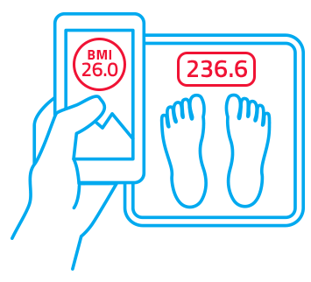
USPSTF Abnormal glucose screening recommendation
Grade B recommendation
• Screen all adults ages 40-70 AND who have a BMI ≥ 25
Screen with a fasting glucose, hemoglobin A1C or oral glucose tolerance test
USPSTF standards suggest testing patients every 3 years
U.S. Preventive Services Task Force. Final Recommendation Statement: Abnormal Blood Glucose and Type 2 Diabetes Mellitus: Screening. April 2018. https://www.uspreventiveservicestaskforce.org/Page/Document/RecommendationStatementFinal/screening-for-abnormal-blood-glucose-and-type-2-diabetes. Accessed March 4, 2019.

Slide 16
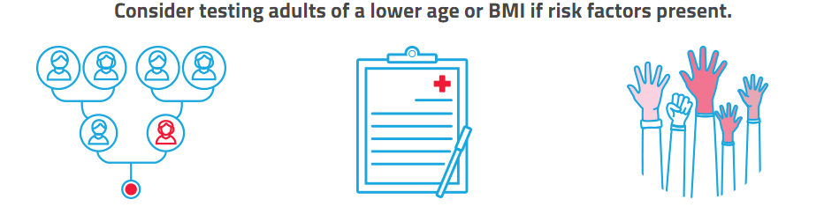
USPSTF Abnormal glucose screening recommendation
Family history
Family history of type 2 diabetes includes first-degree relatives (a person’s parent, sibling or child)
Medical history
Gestational diabetes
Polycystic ovary syndrome
Racial & ethnic minorities
African Americans
American Indians
Alaskan Natives
Asian Americans
Hispanics or Latinos
Native Hawaiians or Pacific Islanders
U.S. Preventive Services Task Force. Final Recommendation Statement: Abnormal Blood Glucose and Type 2 Diabetes Mellitus: Screening. April 2018. https://www.uspreventiveservicestaskforce.org/Page/Document/RecommendationStatementFinal/screening-for-abnormal-blood-glucose-and-type-2-diabetes. Accessed March 4, 2019.

Slide 17
ADA Standards of medical care in diabetes
Informal risk assessment or validated risk assessment tool should be considered in asymptomatic adults
Consider testing adults at any age with BMI ≥25 (≥23 for Asian Americans) and one or more risk factors
    First degree relative with DM
    High-risk race/ethnicity
    History of CVD
    HTN
    HDL <35 mg/dL and/or Triglycerides >250mg/dL
    Women with PCOS
    Physical inactivity
    Conditions associated with insulin resistance
  Begin testing all adults at age 45
  If initial results are normal, repeat testing at a minimum of 3-year intervals
    Consider more frequent testing depending on initial results and risk status
    Women with a history of gestational diabetes should have lifelong testing at least every 3 years
American Diabetes Association. 2.Classification and Diagnosis of Diabetes: Standards of Medical Care in Diabetes- 2019. Diabetes Care. 2019;42(Suppl 1):S13–S28. https://doi.org/10.2337/dc19-S002

Slide 18

National Diabetes Education Program
Guiding Principles for the Care of People with or at Risk for Diabetes
Goal: Identify and synthesize areas of general agreement among existing guidelines
Principle 1: Identify People with Undiagnosed Diabetes and Prediabetes
Principle 2: Manage Prediabetes to Prevent or Delay the Onset of Type 2 Diabetes
Lifestyle intervention with regular activity and dietary change leading to weight loss is the cornerstone of treatment for patients with prediabetes
Consider referral to:
    RD/RDN or diabetes educator
    Structured lifestyle intervention, such as the National Diabetes Prevention Program lifestyle change program
Endorsed by:
American Academy of Family Physicians
American Association of Clinical Endocrinologists
American College of Obstetrics and Gynecology
American Geriatrics Society
American Diabetes Association
Obesity Medicine Association
The Endocrine Society
The Obesity Society
National Diabetes Education Program. Guiding Principles for the Care of People with or at Risk for Diabetes. https://www.niddk.nih.gov/health-information/communication-programs/ndep/health-professionals/guiding-principles-care-people-risk-diabetes. Updated August 2018. Accessed October 24, 2018.

Slide 19
Putting Prevention Into Practice

Slide 20
The care team’s role in preventing diabetes
Create awareness
Identify patients with prediabetes and document the diagnosis
Educate at-risk patients
Refer patients with prediabetes to an evidence-based diabetes prevention program
Follow up on patient progress

Slide 21
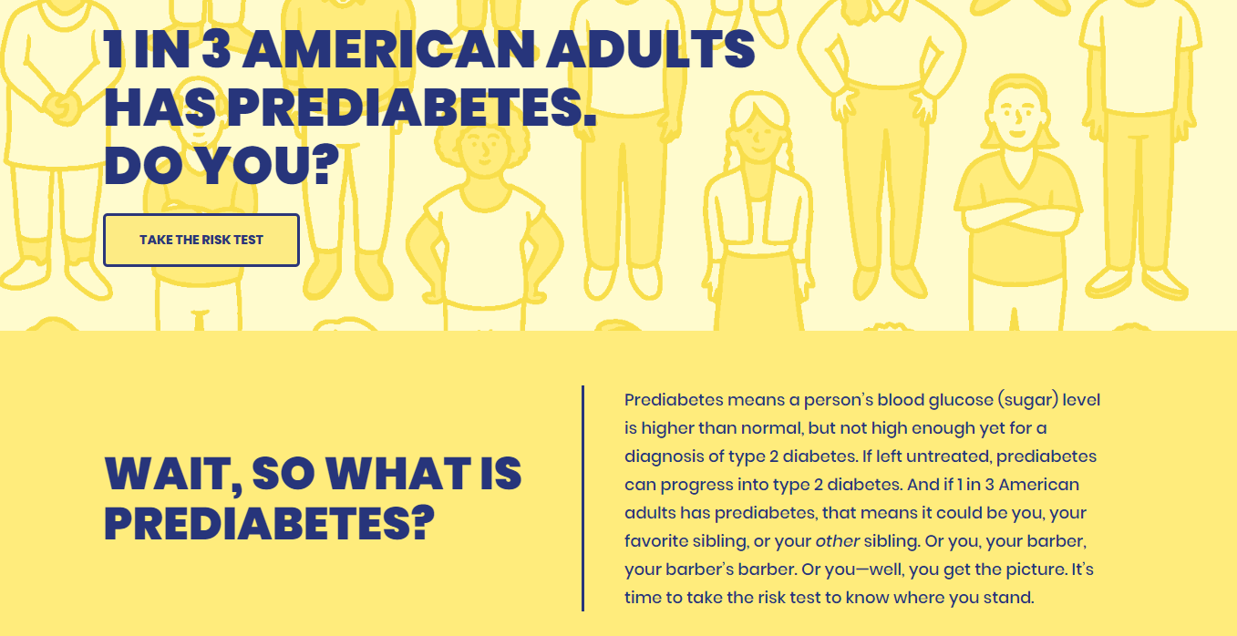

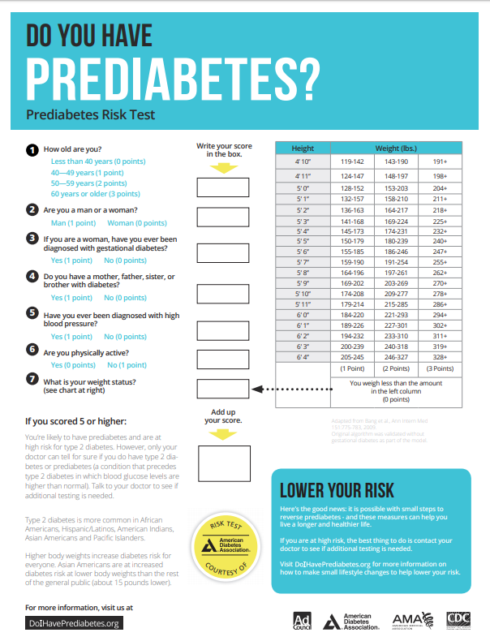
Step One: Create awareness

Slide 22
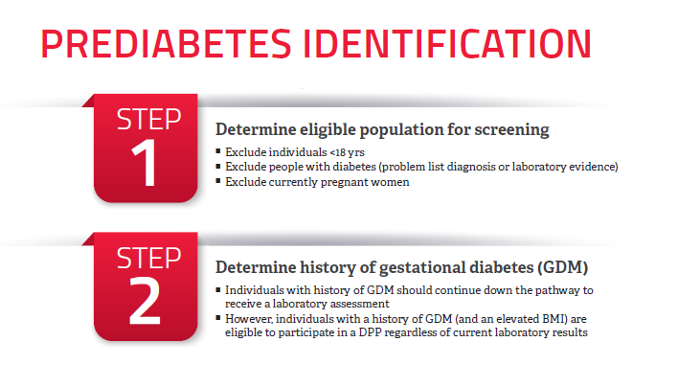
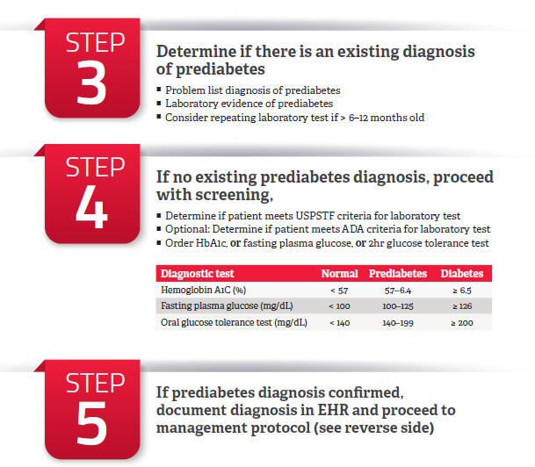
Step Two: Identify patients and document the diagnosis
Document diagnosis:
ICD 10 code is R73.03

Slide 23


Identify eligible patients
Point of Care
Occurs during your patient’s routine office visit. This provides your practice with the ability to engage with your patients face to face, and refer to a course of treatment while your patient is in the office
Care Management
Uses the EHR to create a report based on risk factors and/or lab values to identify patients who meet the criteria for prediabetes.

Slide 24
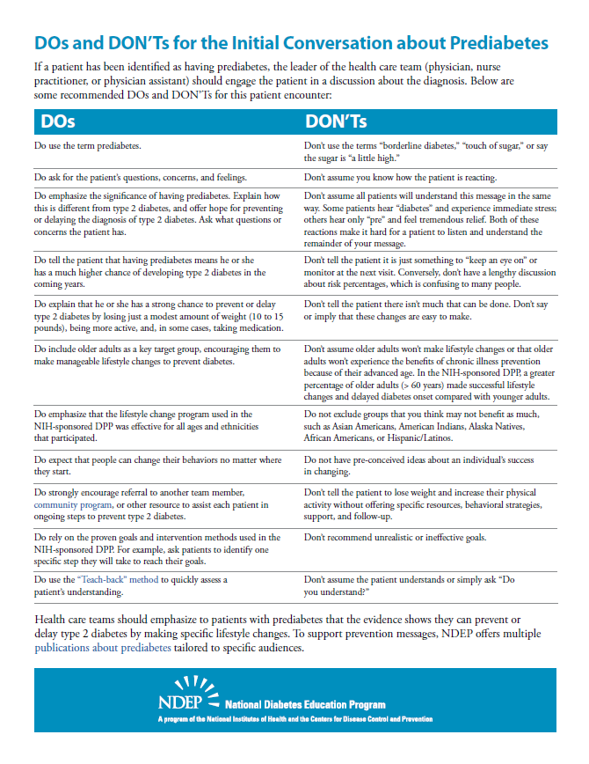
Step Three: Educate at-risk patients
Your blood glucose is higher than normal but not at the level of diabetes. This condition is called prediabetes.
Prediabetes is a serious condition: It poses a high risk of eventually progressing to diabetes and raises your risk of other medical conditions.
Prediabetes is treatable and can be reversible
  The goal is to lose a modest amount of weight (5-7% of body weight) and lead a healthier lifestyle
  A lifestyle change program can help you make lasting healthy behavior changes
National Diabetes Education Program. Guiding Principles for the Care of People with or at Risk for Diabetes. https://www.niddk.nih.gov/health-information/communication-programs/ndep/health-professionals/game-plan-preventing-type-2-diabetes/how-talk-patients-about-prediabetes-diagnosis/dos-donts-initial-conversation-about-prediabetes. Updated August 2018. Accessed March 4, 2019.

Slide 25
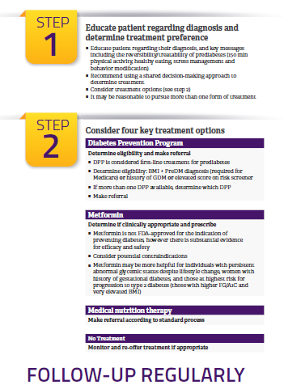
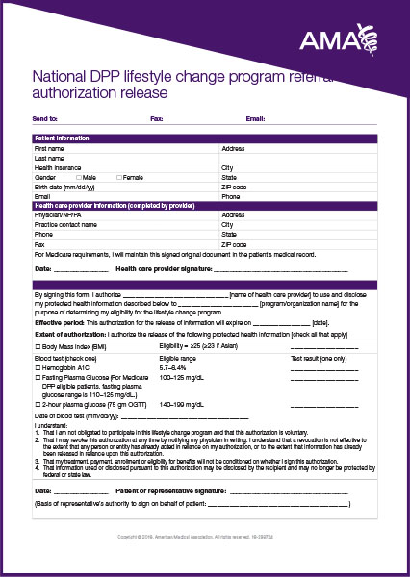
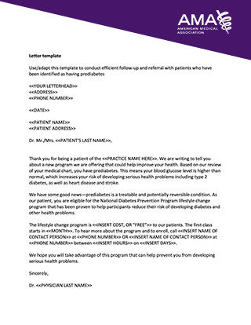
Step Four: Manage and refer patients

Slide 26

Step Five: Monitor progress and follow-up
Arrange follow-up in 3-6 months
Request that the DPP provide reports on patient progress
Monitor your patient’s fasting glucose or hemoglobin A1C every 12 months
Notes:
)

Slide 27
Shared Decision Making

Slide 28

Shared Decision Making
Collaborative process
Arrive at a decision mutually agreeable to patient and clinician
Informed by patient’s values and preferences
American Diabetes Association. 2.Classification and Diagnosis of Diabetes: Standards of Medical Care in Diabetes- 2019. Diabetes Care. 2019;42(Suppl 1):S13–S28. https://doi.org/10.2337/dc19-S002

Slide 29
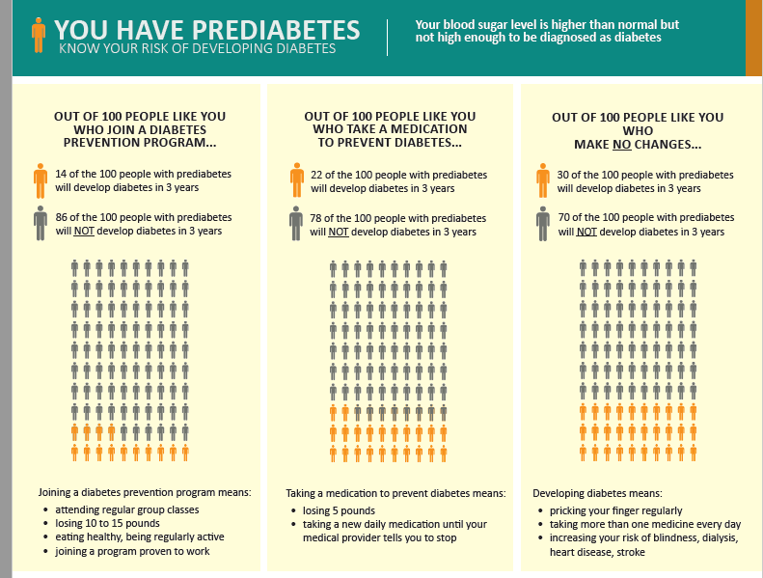
Why SDM Makes Sense for Prediabetes
More than one reasonable option exists
Options are easy to define in lay terms
Pros/cons of each option identify patient preference
American Diabetes Association. 2.Classification and Diagnosis of Diabetes: Standards of Medical Care in Diabetes- 2019. Diabetes Care. 2019;42(Suppl 1):S13–S28. https://doi.org/10.2337/dc19-S002

Slide 30
Medicare DPP Rule and Set of Services

Slide 31
Beneficiary Requirements
•Enrolled in Medicare or Medicare Advantage
•Body Mass Index (BMI) of at least 25 (23 if self-identified as Asian) on the date of the first core session
•Meet 1 of 3 blood test requirements within the 12 months prior to attending the first core session:
•No previous diagnosis of diabetes prior to the date of the first core session (with exception of gestational diabetes
•Do not have end-stage renal disease (ESRD)
•Has not previously received MDPP services

Slide 32
Medicare DPP – Set of Services
MDPP Core Services | Ongoing Maintenance Sessions*
Months 1-6 (Core Sessions) and Months 7-12 (Core Maintenance)
Months 13-24
Months 1-6 (Core Sessions) and Months 7-12 (Core Maintenance)
Months 13-24
All MDPP beneficiaries are eligible for 12 months of core services
5% weight loss is primary goal of core services
Beneficiaries must meet weight loss and attendance goals to be eligible
All MDPP beneficiaries are eligible for 12 months of core services
5% weight loss is primary goal of core services
Beneficiaries must meet weight loss and attendance goals to be eligible
Follows a CDC-approved curriculum
No beneficiary copay
No referral required
* The ongoing maintenance sessions are unique to the MDPP services and not required for CDC recognition.

Slide 33
Medicare Supplier Process
DPRP
Conduct First Cohort
Submit cohort data
Receive preliminary recognition
Submit Medicare Vendor
application
Obtain NPIs

Slide 34
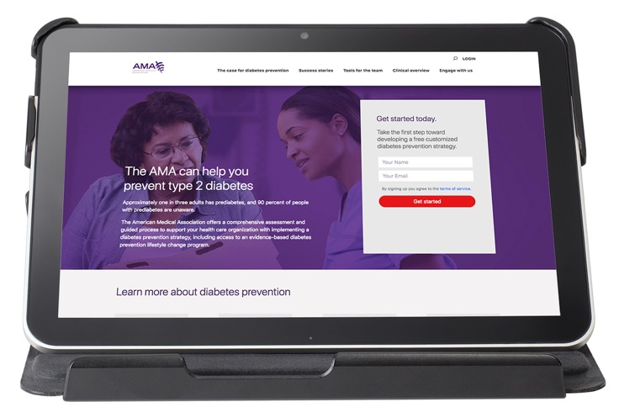
AMA Digital Guide
Step-by-step guidance to implement a diabetes prevention strategy, including a personalized project plan and dashboard
Content related to diabetes prevention including:
  Real-life experiences with diabetes prevention
  Profiles of current health care organizations
  Patient handouts on prediabetes
  The National DPP lifestyle change program, and more
Free access to best practice solutions, tools and resources to assist with planning and executing a diabetes prevention strategy
amapreventdiabetes.org
Notes:
I

Slide 35
Additional Resources:
ACPM: https://www.acpm.org/initiatives/diabetes-prevention/
BWHI: https://bwhi.org/change-your-lifestyle-cyl2/

Slide 36
Questions?

Slide 37
janet.Williams@ama-assn.org

